Slide 1
ISTA 131 Final Project UCL Champions league
Anshul Hallur

Slide 2
UCL Champions League 2021-22
Kaggle dataset containing key statistics for each player
Dataset contains key statistics for each player regarding: Goals, Assists, Attack, Defense, Passing, Field control, GK Data

Slide 3
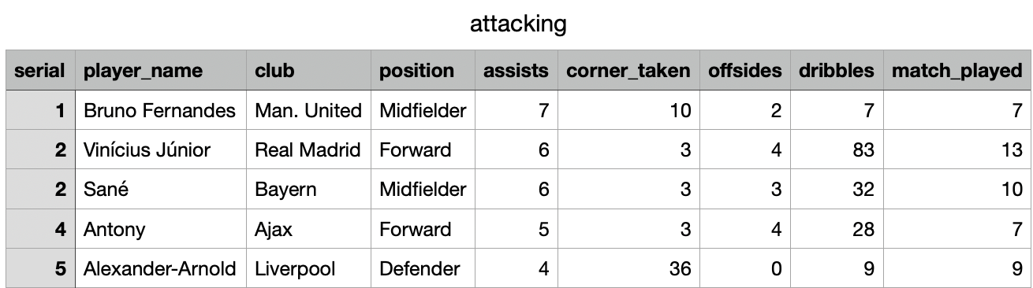
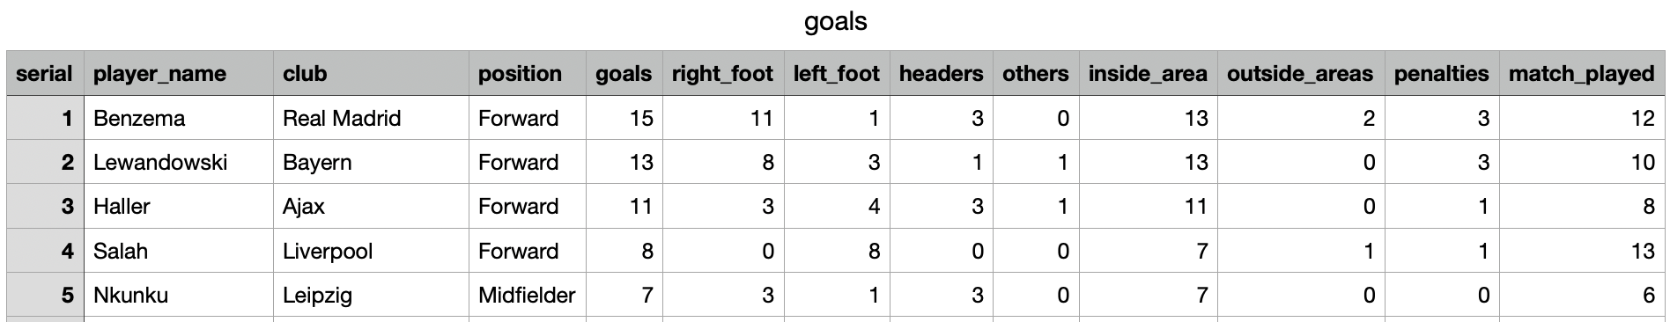
UCL Champions League 2021-22

Slide 4
Questions to consider
Which CLUB NATION has the highest number of assists ?
Is there a significant relationship between assists and goals scored ?

Slide 5
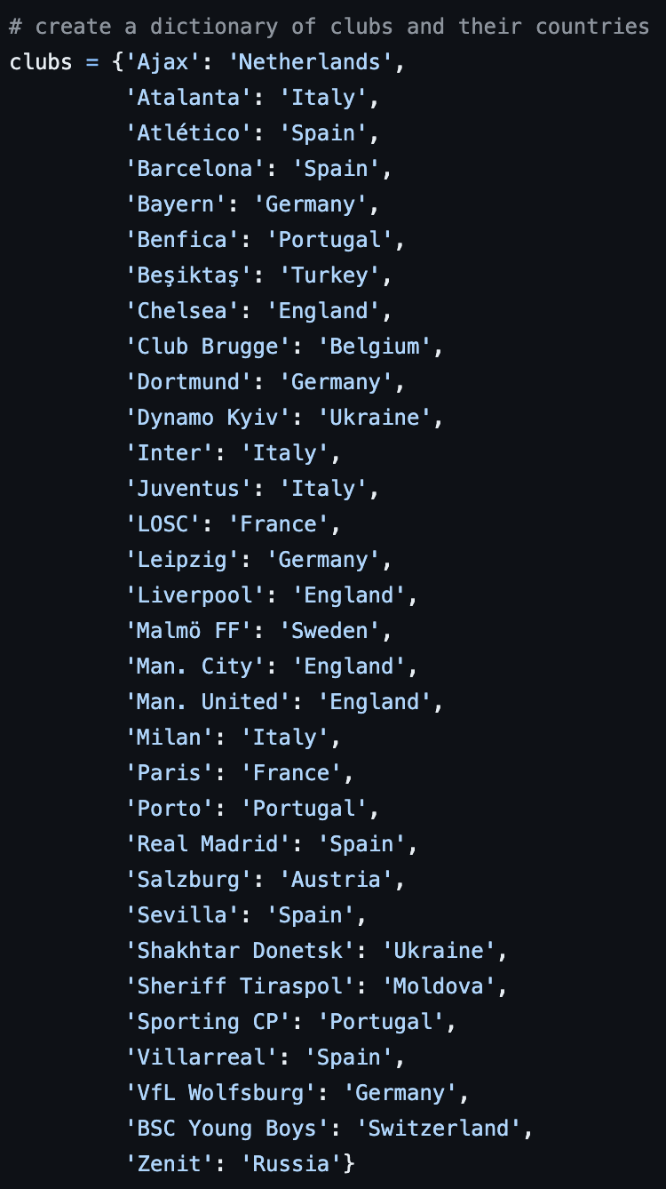

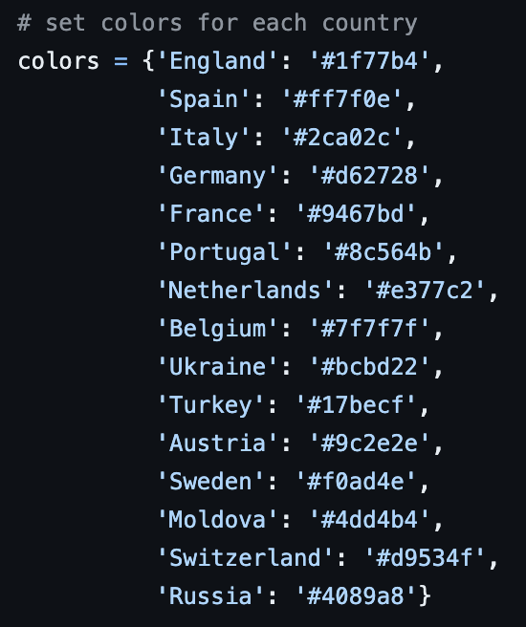
Dictionary for mapping countries to clubs

Slide 6
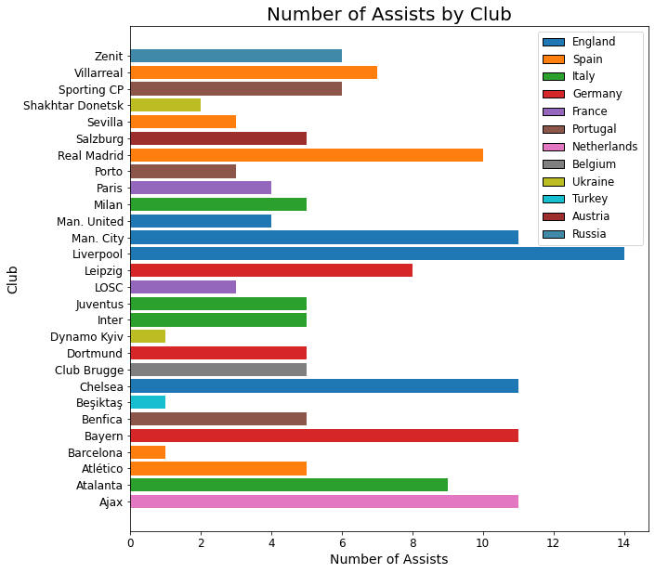
Image 1
Club with highest assists Liverpool
Nation league with
highest assists
England

Slide 7
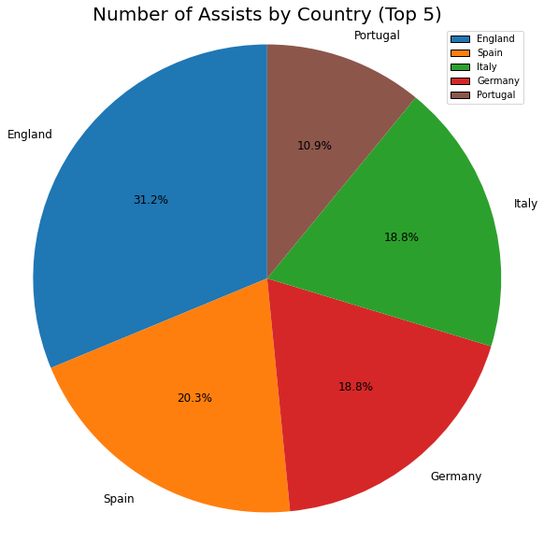
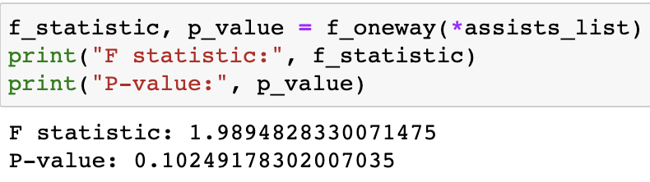
Image 2
ANOVA test results

Slide 8
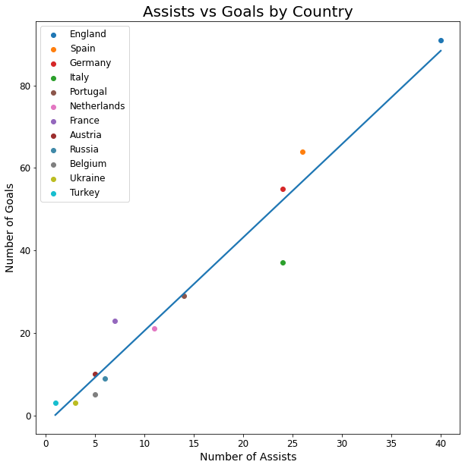
Image 3
Correlation coefficient test result
0.9750748304866191

Slide 9
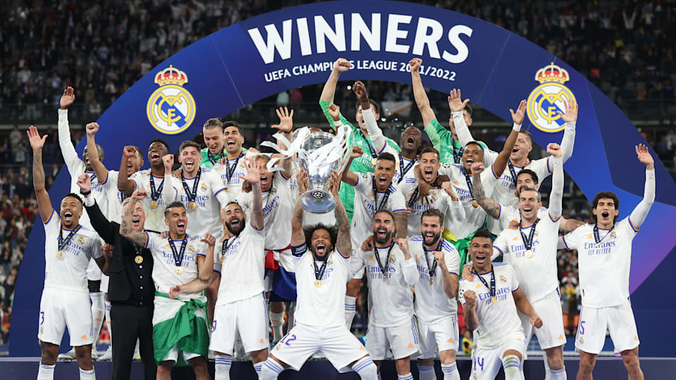
Thank you!

